Slide 1


Cryptography is a mathematical science
Cryptography and Information Theory
Lecture A : Threshold Scheme
Nur Azman Abu
2nd Floor, Right Wing
FTMK, UTeM
Phone : +606-331-6673
Mobile : 0177722007
Email : nura@utem.edu.my
Monday 26 May 2014

Slide 2
Content
  Threshold Scheme
  Difficult Mathematical Problems
  Master Keys
  Threshold Scheme
  Very Important Keys
  Shadow Keys
Asymmetric
Symmetric
OTK
10 September 2007

Slide 3

Modern Cryptography
The security design of modern public-key cryptosystems relies upon the apparent difficult computational problems in number theory.
A computational problem is said to be easy or tractable if it can be solved in polynomial running time.
They are NP-complete problem, integer factorization problem, discrete logarithm problem, quadratic residue problem and a short vector on a square lattice problem.
NPC
IF
DL
QR
L²
Knapsack
Subset Sum
Modern Cryptography
Public Key
Infrastructure
RSA, LUC
ECC, DH
QRC, GM
NTRU
Notes:
Now define some important concepts in abstract algebra - starting with a Group. In abstract algebra, we are concerned with sets on whose elements we can operate algebraically; that is, we can combine two elements of the set to obtain a third element of the set. These operations are subject to specific rules, which define the nature of the set. A group is such a set with properties listed above. We denote a Group as {G,.} We have used . as operator: could be addition +, multiplication x or any other mathematical operator. A group can have a finite (fixed) number of elements, or it may be infinite. Note that integers (+ve, -ve and 0) using addition form an infinite abelian group. So do real numbers using multiplication.

Slide 4


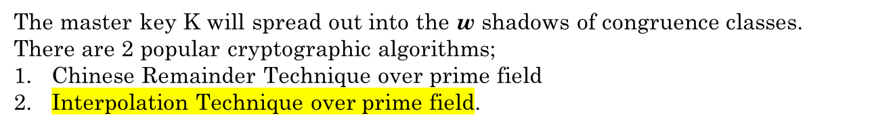
Master Key Threshold Scheme
Shadow Key K₁
Shadow Key K_{w}
Shadow Key K₂
Shadow Key K₇
Master
Key
Shadow Key K₃
Shadow Key K₆
Shadow Key K₄
Shadow Key K₅

Slide 5

Hierarchy of the Very Important Keys(VIK)
Shadow Keys of the Threshold Scheme,
The Master key of the Cryptosystem,
The Public and Private Key of the Public Key Infrastructure and then
The Session Key of the Symmetric Encryption mode.
The higher keys shall be capable of overruling or opening the lower layer keys.

Slide 6
Master Key Setting
Master Key Generator
Random Ambience
Master Key File
Key Injection
PKID Generator Codes
-RSA1024
-ECC256
-NTRU7000
-SHA256
-AES256
-Private Key
-Public Key
Decryption Engine
Session Key
Encryption Engine
-ECC256
-SHA256
-ECC256
-SHA256
Random Ambience
Note: Master Key should be set on demand by the Owner of the cryptosystem

Slide 7
ECC Certificate Generation
PKID
256-bit
Master Key 0
SHA256
AES
256-bit
Master Key 1
SHA256
AES
256-bit
Master Key 9
SHA256
AES
A public key ECC certificate is generated from a unique PKID
Private Key
Base Point
ECC Multiply Point
Public Key
ECC Certificate

Slide 8
Threshold Scheme System
256-bit TSS
Superior Admin
Audit Admin
System Admin
Directory Admin
Security Admin
128-bit TSS
Operation Admins
Support Team
End User
Notes:
COO

Slide 9
Threshold Scheme
Objectives
Threshold scheme provides a solution by breaking the master key into w shadows of keys to w users. The master key can be of valid use by having some t keys together. Anything less than t keys will not be a valid master key. Key recovery can always be done with t shadow keys. Few key lost will not endanger the system.
Panel 1
Panel w
Panel 2
Panel 7
VIKs
Panel 3
Panel 6
Panel 4
Panel 5
10 September 2007
Notes:
Give 3 reason why you need Threshold Scheme

Slide 10
Threshold Scheme
Very Important Keys (VIKs):
Shadow Keys 2048/4096-bit
Master Keys 2048/4096-bit
Public and Private Keys 1024/2048-bit
Symmetric Session Key 128/256-bit
Criteria
Ultimately, the keys are stored in the system and the entire system may depend on a single master key. This master key may be exposed, lost or destroyed. Having copies of the same key to more people will increase the vulnerability of the system from betrayal. Master key is classified as Very Important Keys(VIKs).
10 September 2007

Slide 11
Threshold Scheme using Newton Polynomial mod a prime P = 257. Today, the prime modulo is expected to be 2048-bit.
The policy is m = 5 of n = 8 shadow keys.
Given the master key K =200 as a₀.
Then generate random coefficients a₁, a₂, ..., a_{m−1} < P. Take a polynomial of degree m−1.
Table 1. Coefficients of a Threshold Polynomial
i | 0 | 1 | 2 | 3 | 4
a_{i} | 200 | 11 | 13 | 17 | 19
a_{i} | 200 | -246 | 13 | -240 | 19
10 September 2007

Slide 12
Threshold Scheme
This scheme is based on a traditional polynomial.
The master key K will spread out into the n =8 shadows mod p
Shadow Key K₁
Shadow Key K_{w}
Shadow Key K₂
Shadow Key K₇
Master
Key
Shadow Key K₃
Shadow Key K₆
Shadow Key K₄
Shadow Key K₅
10 September 2007

Slide 13
Threshold Scheme
8. Decompose K into n shadows by evaluating y_{i} =A(x_{i}) for i = 0, …., n−1
9. This is a very crucial ethical step to follow. It will beat the whole purpose without destroying the random source of threshold scheme and the master key
a₀, a₁, a₂, a₃, …, a_{m−1}.
i | 0 | 1 | 2 | 3 | 4 | 5 | 6 | 7
x_{i} | 3 | 5 | 7 | 9 | 11 | 17 | 19 | 23
y_{i} | 35 | 188 | 193 | 138 | 211 | 209 | 48 | 251
10 September 2007

Slide 14
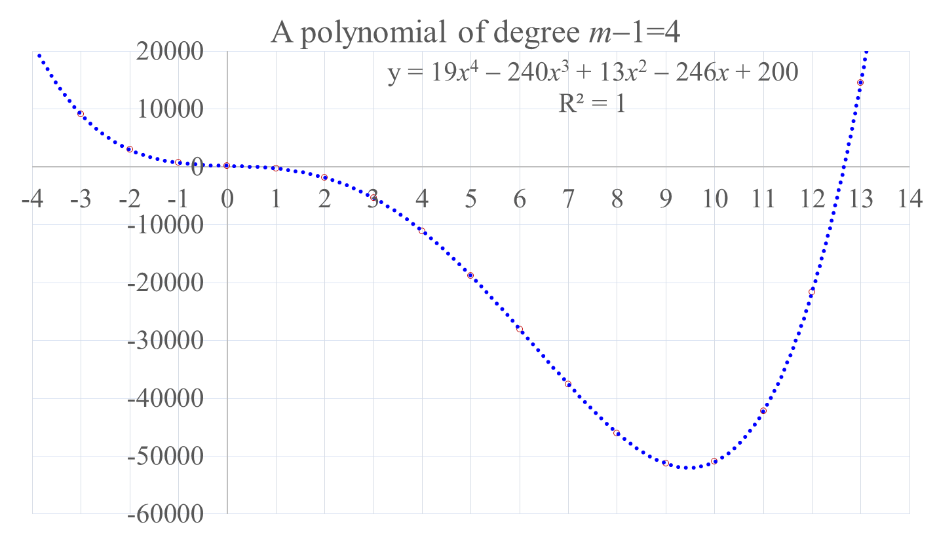
P(x_{i}) = a₄⋅x⁴ + a₃⋅x³ + a₂⋅x² + a₁⋅x + a₀
10 September 2007

Slide 15

Threshold Scheme
10. Deliver the shadow key pairs {x_{i}, y_{i}}to the panels.
i | 0 | 1 | 2 | 3 | 4 | 5 | 6 | 7
x_{i} | 3 | 5 | 7 | 9 | 11 | 17 | 19 | 23
y_{i} | 35 | 188 | 193 | 138 | 211 | 209 | 48 | 251
shadow key
K₀
Let us take the first 5 shadow keys
shadow key
K_{m−1}
shadow key
K₁
master key
?
{x₀, y₀ } | = | { | 3 | , | 35 | }
{x₁, y₁ } | = | { | 5 | , | 188 | }
{x₂, y₂ } | = | { | 7 | , | 193 | }
{x₃, y₃ } | = | { | 9 | , | 138 | }
{x_{n}, y_{n} } | = | { | 11 | , | 211 | }
shadow key
K₃
shadow key
K₂
10 September 2007

Slide 16
A Divided Difference Table
i | x_{i} | y_{i} |  | 2⁻¹ |  |  | 4⁻¹ |  |  | 6⁻¹ |  |  | 8⁻¹
0 | 3 | 35 | nume | deno |  | nume | deno |  | nume | deno |  | nume | deno
 |  |  | 153 | 129 | 205
1 | 5 | 188 |  |  |  | -74 | 193 | 110
 |  |  | 5 | 129 | 131 |  |  |  | 11 | 43 | 216
2 | 7 | 193 |  |  |  | -30 | 193 | 121 |  |  |  | -105 | 225 | 19
 |  |  | -55 | 129 | 101 |  |  |  | -105 | 43 | 111
3 | 9 | 138 |  |  |  | 64 | 193 | 16
 |  |  | 73 | 129 | 165
4 | 11 | 211
10 September 2007

Slide 17
An interpolating polynomial is given by
P(x) = 35
+ 205⋅(x− 3)
+ 110⋅(x− 3)⋅(x− 5)
+ 216⋅(x− 3)⋅(x− 5)⋅(x− 7)
+ 19⋅(x− 3)⋅(x− 5)⋅(x− 7)⋅(x− 9)
A target regenerated master is an intercept value of P(x) evaluated at x = 0.
P(0) = 35
+ 205⋅(0− 3)
+ 110⋅(0− 3)⋅(0− 5)
+ 216⋅(0− 3)⋅(0− 5)⋅(0− 7)
+ 19⋅(0− 3)⋅(0− 5)⋅(0− 7)⋅(0− 9)
= 35 – 615 + 1650 – 22680 + 17955 = –3655 ≡ 200 (mod 257).
10 September 2007

